Slide 1

School of Computing
Vel Tech Rangarajan Dr. Sagunthala R&D Institute of Science and Technology
Department of Computer Science and Engineering
10211CS224 / FULL STACK APPLICATION DEVELOPMENT (JAVA)
PROJECT REVIEW : MILESTONE PROJECT – 1
Date: 23-03-2026
Real-Time Event Synchronization Engine
SDG: SDG 4 – Quality Education
Presented By:
V.Venkata Siva Prasad – VTU26004 – 23UECS0585
Courses Handling Faculty:
Dr. Angeline Lydia

Slide 2
INTRODUCTION
The Real-Time Event Synchronization Engine is a web-based application designed to manage and display events dynamically in real time.
It enables users to create, update, and view events instantly without refreshing the web page.
The system uses AJAX (Asynchronous JavaScript and XML) to ensure real-time communication between the client and server.
The front-end is developed using HTML5, CSS3, and JavaScript (ES6) to provide an interactive and user-friendly interface.
The back-end is built using PHP, which handles server-side logic and database operations.
MySQL database is used to store user information and event details securely.
The application includes features like:
User Registration
User Login Authentication
Event Creation
Event Dashboard Display
The system supports real-time data synchronization, ensuring all users see updated information instantly.
Tools like XAMPP/Tomcat are used to create a local server environment for development and testing.
The project demonstrates the integration of web technologies and database systems to build scalable and efficient real-time applications.
1
2
3
4
5
6
7
8
9

Slide 3
PROBLEM STATEMENT
Traditional web applications require manual page refresh to view updated information, which leads to delays in accessing new data.
There is a lack of efficient systems to synchronize event updates in real time across multiple users.
Existing systems often fail to provide instant notifications and updates, causing communication gaps.
Managing events manually can lead to data inconsistency and redundancy in databases.
Users face difficulties in tracking and managing events dynamically in a centralized system.
Many applications lack proper user authentication and secure data handling, leading to potential security issues.
There is a need for a system that can handle multiple users simultaneously without performance degradation.
Current solutions do not effectively use modern web technologies like AJAX for seamless data updates.
Organizations require a platform that ensures efficient event management with minimal latency.
Hence, there is a need to develop a Real-Time Event Synchronization Engine that provides dynamic updates, secure data handling, and efficient event management.
1
2
3
4
5
6
7
8
9

Slide 4
OBJECTIVE(S)
1
To develop a dynamic web application for managing and synchronizing events in real time.
To implement real-time data updates using AJAX without requiring page refresh.
To design a user-friendly interface using HTML5, CSS3, and JavaScript (ES6).
To build a secure user authentication system with registration and login functionality.
To store and manage data efficiently using a MySQL database.
To enable users to create, view, and manage events easily through a centralized dashboard.
To ensure data consistency and integrity across multiple users.
To provide fast and reliable communication between client and server.
To integrate front-end and back-end technologies for a complete full-stack solution.
To create a scalable system that can handle multiple users and real-time operations efficiently.
2
3
4
5
6
7
8
9

Slide 5
PROPOSED SYSTEM
The proposed system is a Real-Time Event Synchronization Engine that enables dynamic event management with instant updates.
It provides a web-based platform where users can register, log in, and manage events efficiently.
The system uses AJAX technology to fetch and update event data in real time without refreshing the page.
A centralized MySQL database is used to store user details and event information securely.
The application ensures real-time synchronization, so all users can view updated event data instantly.
It includes a dashboard interface where users can:
Add new events
View existing events
6 • Monitor updates dynamically
The system implements secure authentication to protect user data and restrict unauthorized access.
The backend, developed using PHP, handles database operations, user sessions, and server-side processing.
The frontend, built with HTML5, CSS3, and JavaScript (ES6), ensures a responsive and interactive user experience.
The system is deployed using XAMPP/Tomcat, providing a reliable environment for development and testing.
It reduces manual effort by automating event updates and synchronization processes.
The proposed system is scalable and efficient, capable of handling multiple users and real-time data operations simultaneously.
1
2
3
4
5
7
8
9

Slide 6
PROPOSED SYSTEM ARCHITECTURE
1
The system follows a 3-tier architecture consisting of:
2
Presentation Layer (Frontend)
3 • Application Layer (Backend)
Data Layer (Database)
4
5
6
7
8
9

Slide 7
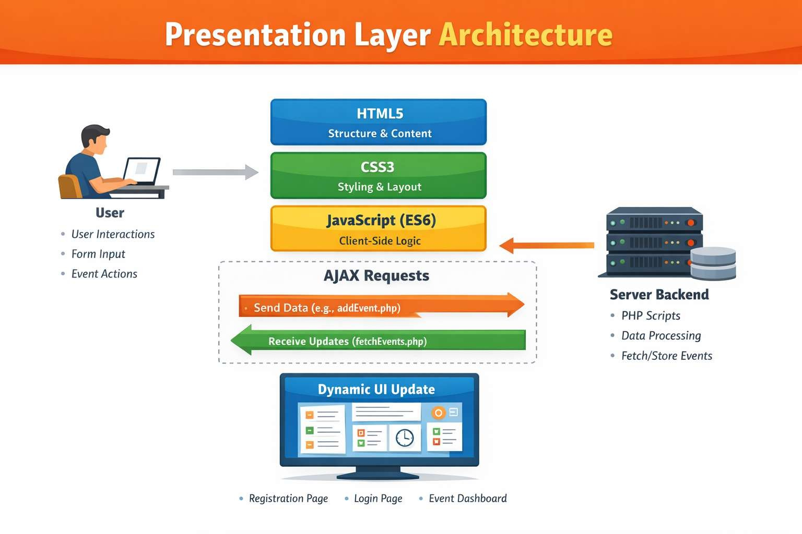
Presentation Layer (Client Side)
Built using HTML5, CSS3, and JavaScript (ES6)
Provides user interfaces such as:
Registration page
Login page
Event dashboard
Sends user requests to the server using AJAX
Displays real-time updates without page reload

Slide 8
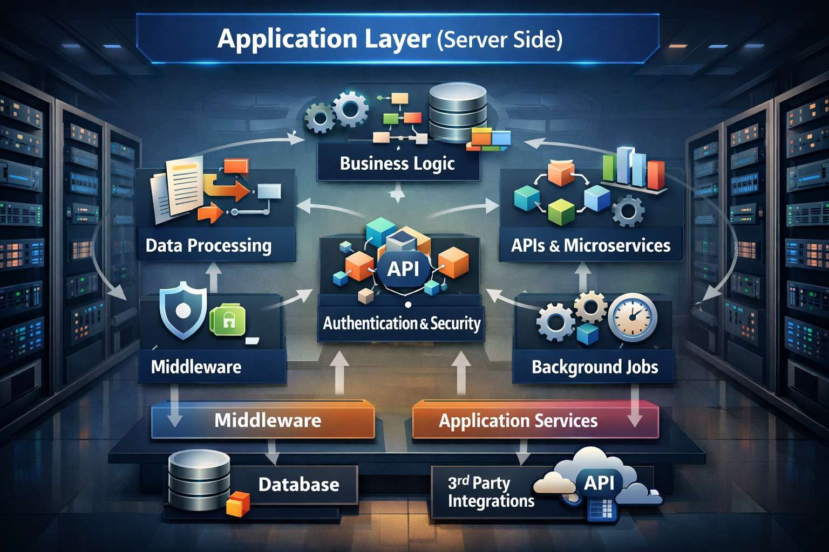
Application Layer (Server Side)
Developed using PHP to handle business logic.
Responsible for:
Processing user requests
Managing sessions (login/logout)
Validating input data
Handling event creation and retrieval
Acts as a bridge between frontend and database.
3. Uses API-like endpoints such as:
addEvent.php
fetchEvents.php
login.php
register.php

Slide 9
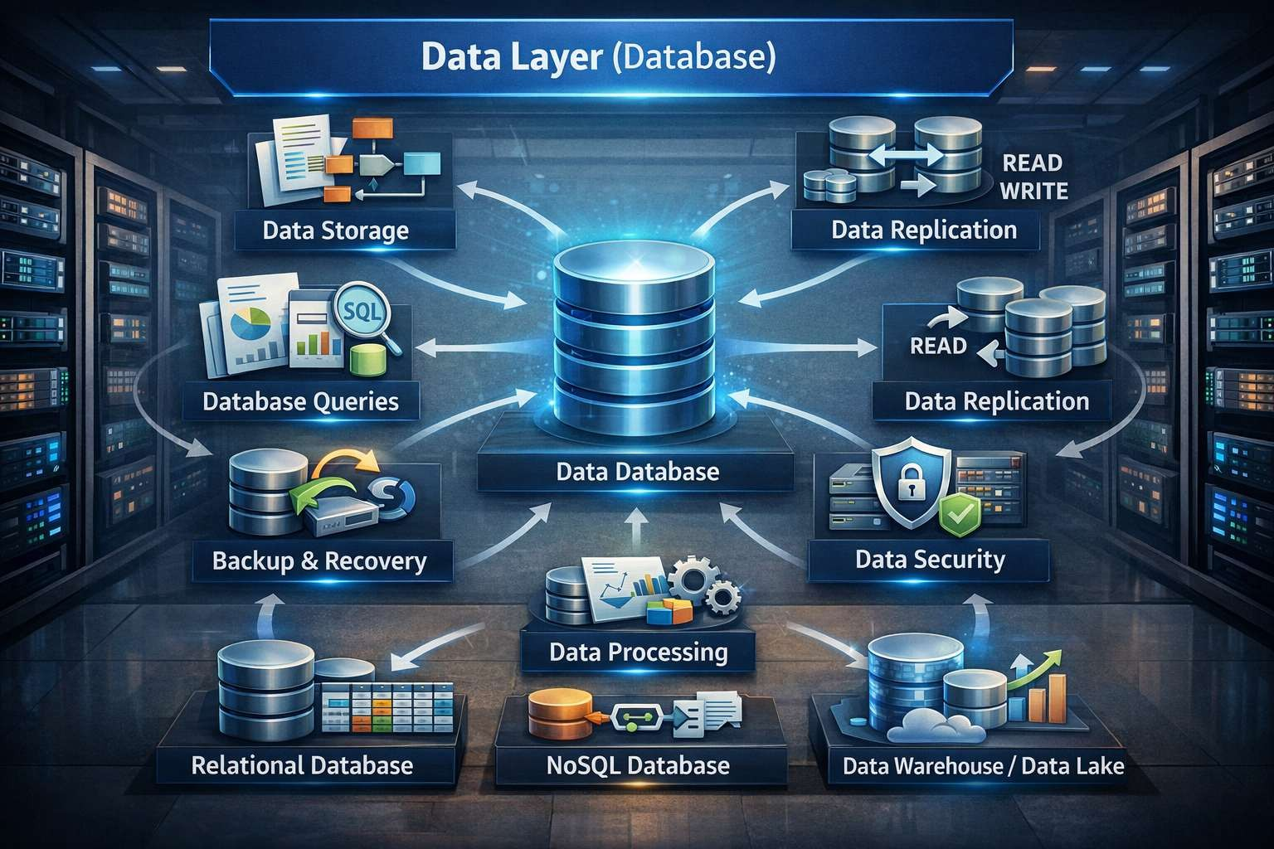
Data Layer (Database)
Implemented using MySQL.
Stores:
User details (username, password)
Event details (type, data, timestamp)
3. Ensures data consistency, integrity, and security.

Slide 10
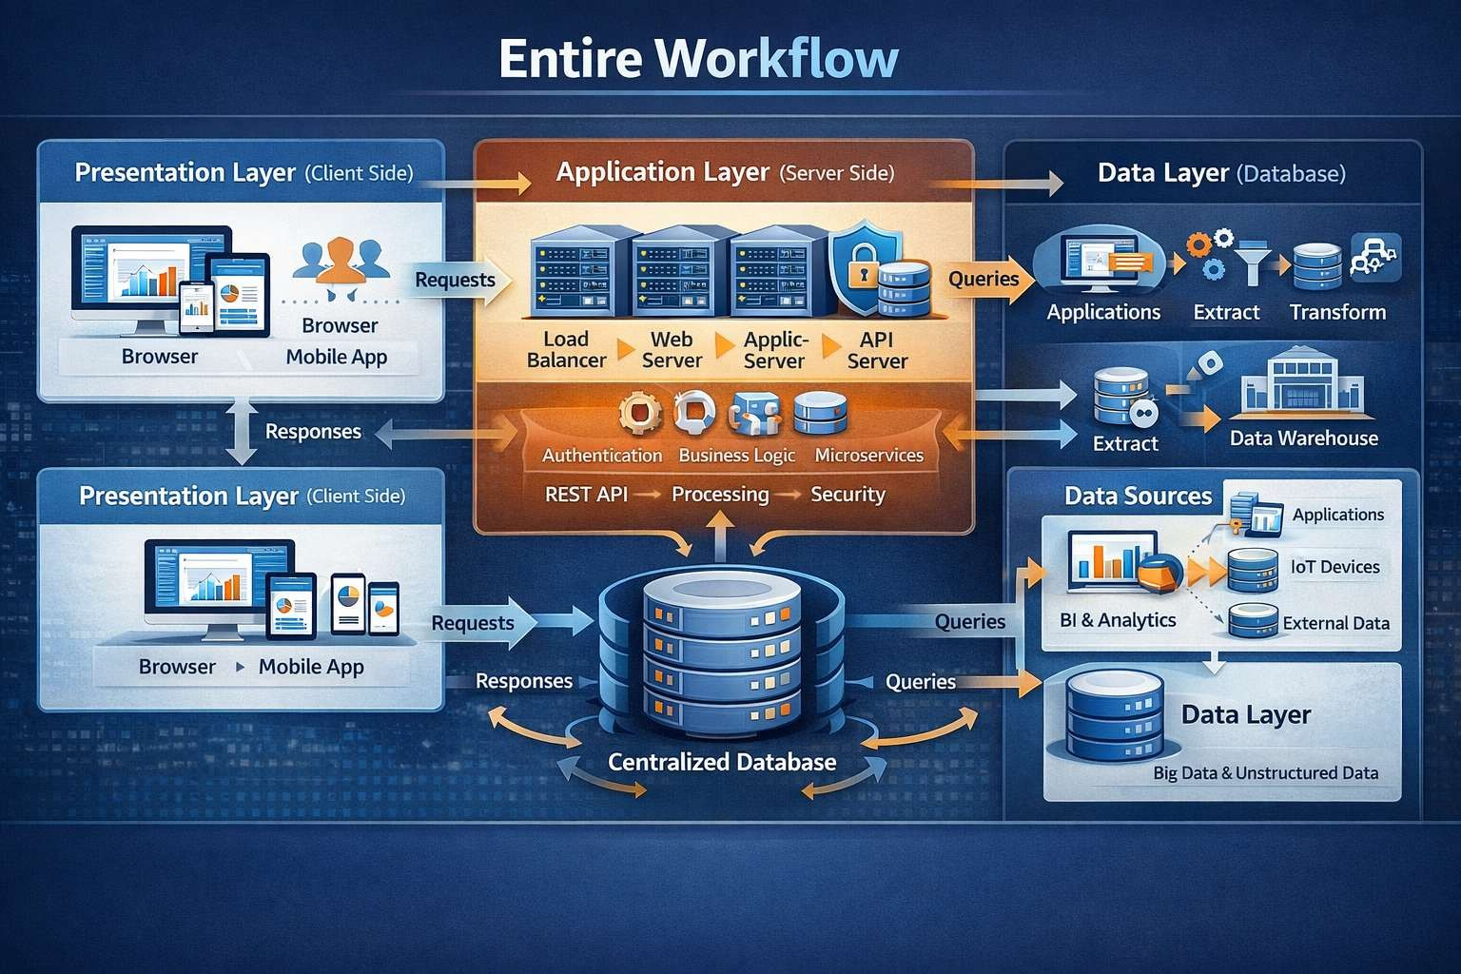
WORKFLOW
1
2
3
4
5
6
7
8
9

Slide 11
TECHNOLOGIES USED
Frontend Technologies
1. HTML5
Used for structuring web pages
2. CSS3
Backend Technologies
1. PHP
Server-side scripting language
1
2
Apache Server
Handles HTTP requests and responses
3. XAMPP
3
Used for styling and responsive design
3. JavaScript
Handles client-side interactions
4
Local server environment (Apache + MySQL + PHP)
4. REST/API Communication
Connects frontend and backend
AJAX
Enables real-time updates without page reload
5
6
5. Bootstrap (Optional)
7 • Improves UI responsiveness
8
Database Technologies
1. MySQL
Stores application data
2. phpMyAdmin
9
GUI tool to manage databases
3. SQL
Used for CRUD operations (Create, Read, Update, Delete)

Slide 12
MODULE DESCRIPTION
1. User Module
1
Users can register and use the system.
2. Authentication Module
2
Handles login and logout securely.
3. Event Management Module
3
4
Users can add, view, update, and delete events.
4. AJAX Module
5
Updates events in real time without refreshing the page.
5. Database Module
6
Stores user and event data in MySQL.
6. Integration Module
7
Connects frontend, backend, and database.
7. Admin Module (Optional)
Admin manages users and system activities.
8
9

Slide 13
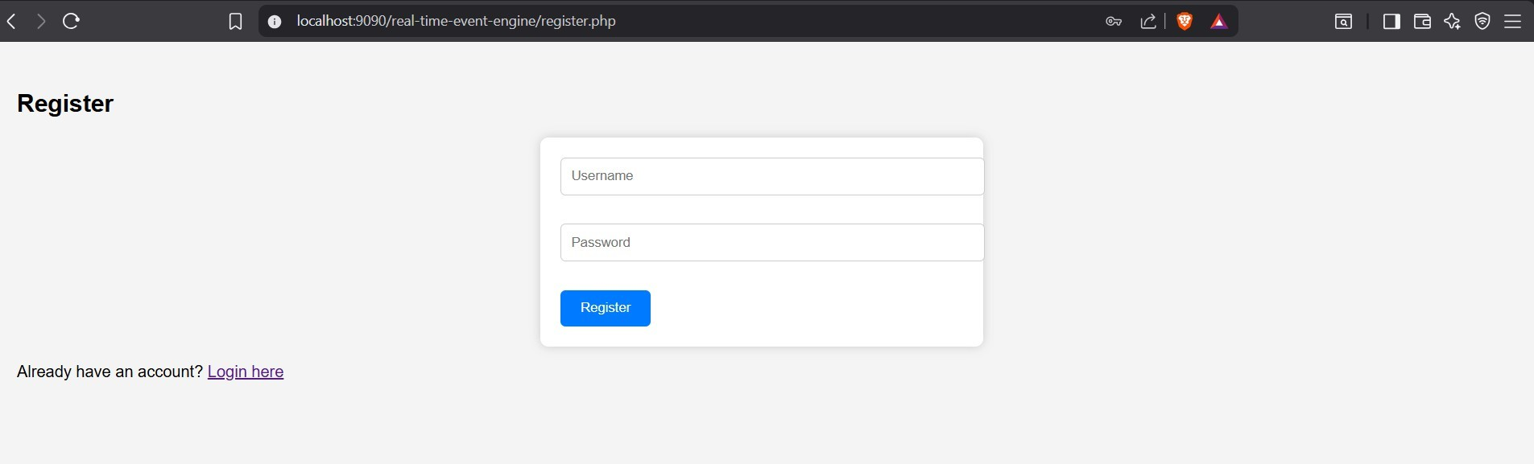
IMPLEMENTATION SCREENSHOTS
1
2
3
4
5
6
7
8
9

Slide 14
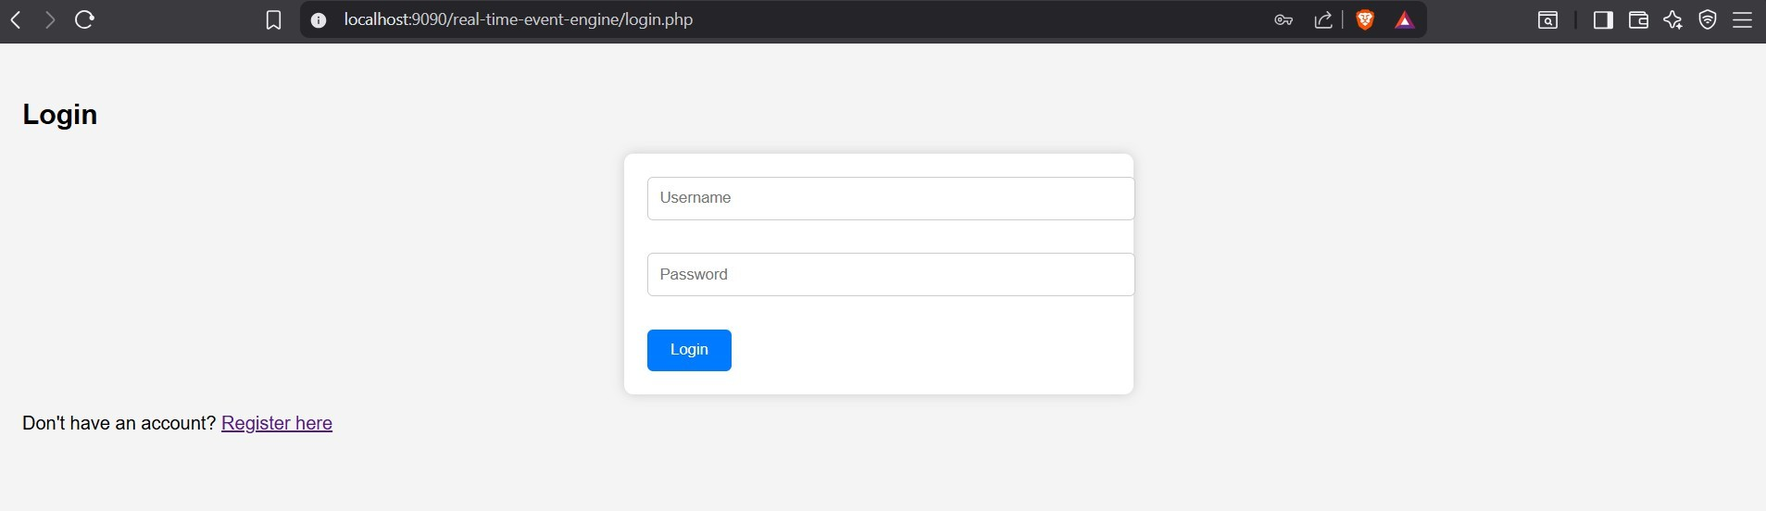
IMPLEMENTATION SCREENSHOTS
1
2
3
4
5
6
7
8(A)
9

Slide 15
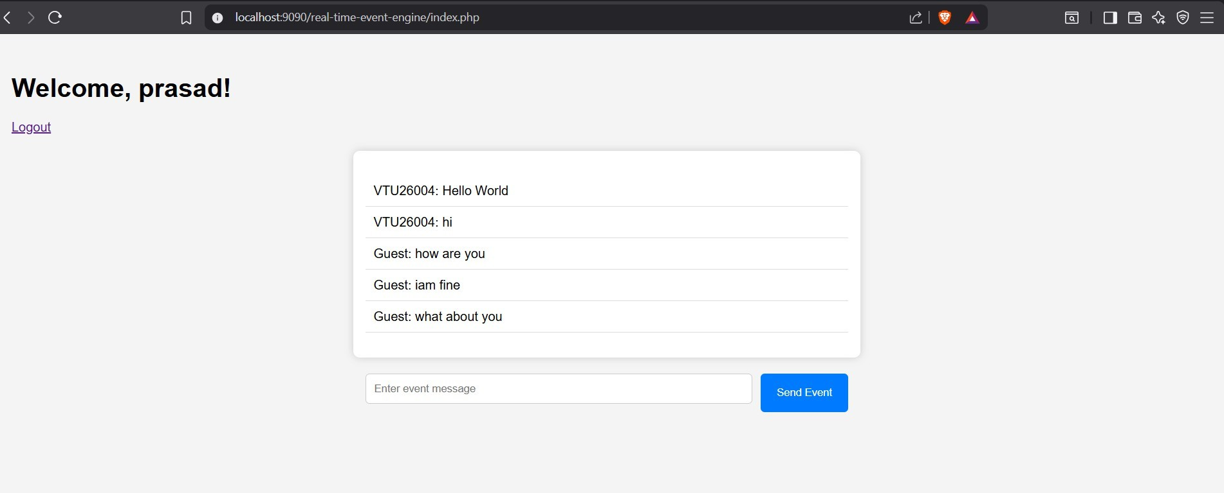
IMPLEMENTATION SCREENSHOTS
1
2
3
4
5
6
7
8(B)
9

Slide 16
ADVANTAGES & LIMITATIONS
1
ADVANTAGES:
Provides real-time updates without page refresh
Improves user experience with fast response
Ensures efficient event management
Supports multiple users simultaneously
Uses simple and widely used technologies (PHP, MySQL)
Easy to develop and maintain
Reduces manual work and data redundancy
2
3
4
5
6
7
LIMITATIONS:
Requires continuous internet connection
Real-time updates using AJAX polling may increase server load
Limited scalability for very large systems
Security depends on proper implementation
Not fully real-time like WebSockets (uses polling)
Performance may reduce with large data volume
8
9

Slide 17
Thank you

